Slide 1
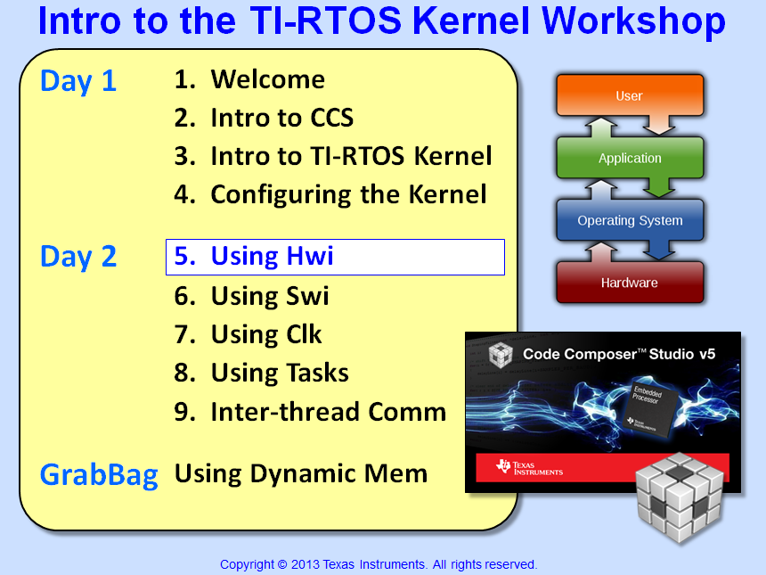


Slide 2
Objectives
Describe how interrupts work in general and on each architecture
Learn how to configure TI-RTOS Hwi’s for each architecture (similar and different)
Explain how to nest interrupts using TI-RTOS
Compare/contrast kernel-managed interrupts with the interrupt keyword (non-BIOS)
Lab – Add an Hwi to respond to a timer interrupt that blinks the LED

Slide 3
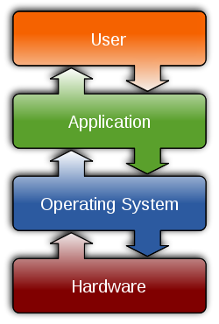
Outline
Hardware Interrupts (Hwi)
How Interrupts Work
Configuring an Hwi
Managing ISRs – Two Ways
Hwi Benchmarks
Lab

Slide 4
SYS/BIOS Thread Types (including Tasks)
Hwi
Hardware Interrupts
Hardware event triggers Hwi to run
BIOS handles context save/restore, nesting
Hwi triggers follow-up processing
Priorities set in silicon
Swi
Software Interrupts
Software posts Swi to run
Performs Hwi ‘follow-up’ activity (process data)
Up to 32 priority levels (16 on C28x/MSP430)
Priority
Task
Tasks
Usually enabled to run by posting a ‘semaphore’ (a task signaling mechanism)
Designed to run concurrently – pauses when waiting for data (semaphore)
Up to 32 priority levels (16 on C28x/MSP430)
Idle
Background
Runs as an infinite while(1) loop
Users can assign multiple functions to Idle
Single priority level
Hwi and Idle – in code...
Notes:
Using Clock Fxns in a Task-based video system is not really recommended because Clock Functions will ALWAYS have a higher priority than TSKs because periodic functions s are prioritized as Swis.

Slide 5
Foreground / Background Scheduling
main()
{ init
while(1)
nonRT }
main() { init BIOS_start() }
Scheduler
Idle nonRT + instrumentation
ISR get buffer process printf()
Hwi get buffer process LOG_info1()
Idle events run in sequence when no Hwis are posted
Hwi is ISR with automatic vector table generation + context save/restore
Hwi performs “process” – typical use is to perform HRT need, then post “follow-up activity”

Slide 6
Outline
Hardware Interrupts (Hwi)
How Interrupts Work
Configuring an Hwi
Managing ISRs – Two Ways
Hwi Benchmarks
Lab

Slide 7
How do Interrupts Work?
An interrupt occurs
UART
GPIO
Timers
Ext pins
Etc.
2. Sets a flag in a register
. . .
How are interrupts "enabled"?

Slide 8
Receiving Interrupts (with BIOS Functions)
IFR
Interrupt Flag
IER
“Individual Enable”
GIE
“Master Enable”
GPIO
0
CPU
UART
1
etc …
0
Interrupt Flag Reg (IFR)
bit set when int occurs
Hwi_post();
Hwi_clearInterrupt()
Global Interrupt Enable (GIE) Enables ALL IER-enabled interrupts
Hwi_enable()
Hwi_disable()
Hwi_restore()
Interrupt Enable Reg (IER) turns on individual ints
Hwi_disableInterrupt();
Hwi_enableInterrupt();
Note: Hwi_post() not supported on MSP430
Notes:
Uint32 gie;
…
gie = IRQ_globalDisable();
...
IRQ_globalRestore(gie);

Slide 9
How do Interrupts Work?
An interrupt occurs
3. CPU acknowledges interrupt and …
Stops what it is doing
Turn off interrupts globally
Clears flag in register
Saves return-to location
Determines which interrupt
Calls ISR
UART
GPIO
Timers
Ext pins
Etc.
4. ISR (Interrupt Service Routine)
Saves context of system*
Runs your interrupt code (ISR)
Restores context of system*
Continues where it left off*
* Must be done in user code, unless you use SYS/BIOS
2. Sets a flag in a register
. . .

Slide 10
Outline
Hardware Interrupts (Hwi)
How Interrupts Work
Configuring an Hwi
Managing ISRs – Two Ways
Hwi Benchmarks
Lab

Slide 11


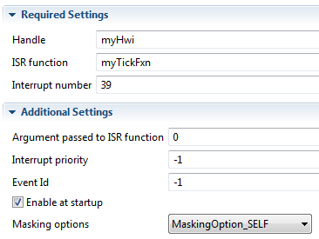
Configuring an Hwi – Statically via GUI
Example:
Tie Tiva Timer2A to the CPU’s HWI₅
1
Use Hwi module (Available Products) , insert new Hwi (Outline View)
Remember, BIOS objects can be created via the GUI, script code or C code (dynamic)
2
Configure Hwi – Event ID, CPU Int #, ISR vector:
User can configure:
Handle – name of object
ISR fxn (e.g. myTickFxn)
Interrupt number (from datasheet, e.g. Timer2A = 39)
Priority & Event Id (arch-specific)
Enable at startup (IER)
Masking options (nesting) (more later)
Let's look at each device's Hwi config - one at a time...

Slide 12
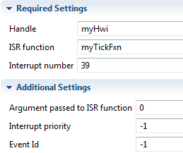
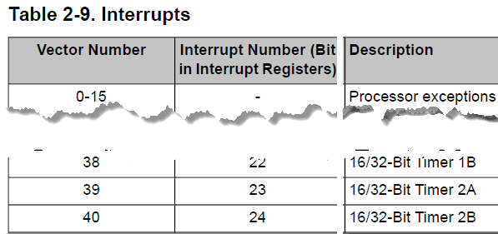
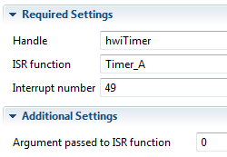
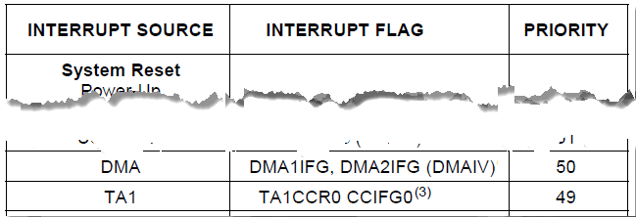
Hwi Configuration – Tiva & MSP430
Tiva - C
Interrupt number comes from datasheet
Interrupt Priority specifies Priority Group:
0x00 (0), 0x20 (1), …, 0xe0 (7) = default “-1”
Event Id: Shown but NOT applicable
MSP430
Interrupt number comes from datasheet
Interrupt Priority and Event Id are not used

Slide 13
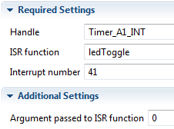
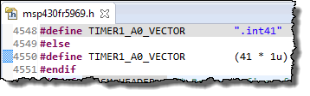
Hwi Configuration – Tiva & MSP430
Tiva - C
Interrupt number comes from datasheet
Interrupt Priority specifies Priority Group:
0x00 (0), 0x20 (1), …, 0xe0 (7) = default “-1”
Event Id: Shown but NOT applicable
MSP430
FR5969
Interrupt number comes from header file:
Interrupt Priority and Event Id are not used

Slide 14
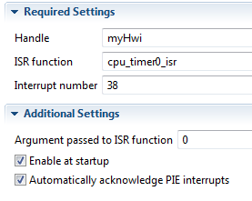
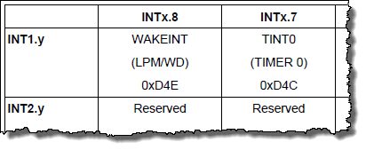
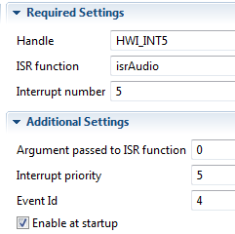
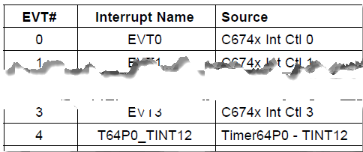
Hwi Configuration – C28x & C6000
C28x
Interrupt number comes from PIE table:
Interrupt Priority and Event Id not used
BIOS can auto acknowledge PIE interrupts INT1.7 equates to “38” in BIOS Hwi
C6000
Interrupt number (User INTs #4-15)
Interrupt priority – N/A
Event Id comes from datasheet:
Nesting interrupts...

Slide 15
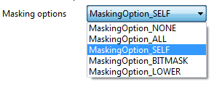
Nesting – Enabling Preemption of Hwi
Default mask is “SELF” – which means all other Hwi’s can pre-empt it except for itself (i.e. BIOS allows nesting by default).
Can choose other masking options as required:
ALL: Best choice if ISR is short & fast (does not work on M4)
NONE: Dangerous – make sure ISR code is re-entrant (no M4)
BITMASK: User can choose specific interrupts to nest (no M4)
LOWER: Masks any interrupt(s) with lower priority (ARM only)
Note: BIOS does not support nested interrupts for MSP430
Notes:
Note: See .s62 file for vector table. For DSP (C6000, C28x, any NON-ARM device), “LOWER” compiles to “SELF” – so it is not supported. However, “LOWER” does make sense for ARM devices (M3, Cortex-A8, etc). For M4, only SELF and LOWER are supported.

Slide 16
Outline
Hardware Interrupts (Hwi)
How Interrupts Work
Configuring an Hwi
Managing ISRs – Two Ways
Hwi Benchmarks
Lab

Slide 17
Using the BIOS Hwi Dispatcher
currently_executing_code
{
interrupt occurs
next_line_of_code
}
Vector Table
Hwi Dispatcher:
Context Save
Context Restore
“Smart” Return
BIOS Hwi Dispatcher
Easy to use, simple, RECOMMENDED
Turned ON for every BIOS Hwi
Slight increase in latency due to full context save/restore
Allows BIOS Scheduler function calls
Saves code space (all INTs share common save/restore routine)
Performs “smart return” – returns to highest priority pending thread
void myHwi(arg)
{
READ_HW_PORT;
Swi_post();
}
Using interrupts withOUT BIOS...

Slide 18
Using the interrupt Keyword
currently_executing_code
{
interrupt occurs
next_line_of_code
}
Vector Table
interrupt myHwi(void)
{
context save; //nest?
READ_HW_PORT;
Process; //??
Swi_post();
context restore;
}
Interrupt Keyword
Compiler handles context save/restore
Call a function? Then full context is saved
Nesting interrupts is MANUAL
Users canNOT call any BIOS Scheduler functions (e.g. Swi_post)
Use ONLY if absolute minimum latency is required in your system (and then, just maybe)
Summary...

Slide 19
Interrupt Creation Summary
BIOS Hwi Dispatcher
Allows nesting of interrupts
Saves code space
Required when ISR uses BIOS scheduler functions
Performs a smart return to highest priority pending thread
Interrupt Keyword
Slight advantage (only if absolute MIN latency required)
Notes:
Choose HWI dispatcher OR Interrupt keyword on an interrupt-by-interrupt basis
Caution:
For each interrupt, use only one of these two interrupt context methods

Slide 20
Outline
Hardware Interrupts (Hwi)
How Interrupts Work
Configuring an Hwi
Managing ISRs – Two Ways
Hwi Benchmarks
Lab

Slide 21
Interrupt Response Time
~CPU Cycles from trigger to first line of ISR code:
 | C28x | MSP430 | Tiva-C
Non-BIOS-Mg’d | 30 | 25 | 25
BIOS-Mg’d (MIN) | 193 | 32 | 101
BIOS-Mg’d (DEFAULT) | 226 | 96 | 114
“Non-BIOS Mg’d” means interrupt not managed by BIOS (vector must be “plugged” manually)
Application test code (from author) run from FLASH (some wait states)
“DEFAULT” means that the default services for the interrupt are selected (mostly ALL of them).
Users can improve cycle count by turning off some features and/or running from RAM (see “MIN” numbers, where all BIOS features are turned off)
Published “interrupt latency” numbers in BIOS Benchmarks describe the longest time interrupts are disabled anywhere in the O/S.
Benchmark projects available in the \TI_RTOS folder
How do you create a "zero latency" interrupt ?

Slide 22




Non-BIOS Managed INT Creation
TM4C
Easiest of them all – simply define the INT in the CFG file and choose Priority Group ZERO
Then use interrupt keyword for the ISR:
MSP430
Cannot define “zero latency” interrupt in the BIOS GUI
User must manually use #pragma to “plug” the vector and then use the interrupt keyword:
C28x
Define “zero latency” interrupt in the BIOS GUI (Hwi → Advanced, Ex: 0x10 is INT5):
C6000
Cannot define “zero latency” interrupt in the BIOS GUI
User must use Hwi_plug() to “plug” the vector table + Hwi_eventMap() for EventId
Hwi_plug(5, (Hwi_PlugFuncPtr)isr_nonBIOS);
Hwi_eventMap(5, 64);

Slide 23
Outline
Hardware Interrupts (Hwi)
How Interrupts Work
Configuring an Hwi
Managing ISRs – Two Ways
Hwi Benchmarks
Lab

Slide 24
Labs 5-9 “Roadmap”
Lab | Trigger | Hwi | Other | Fxn
5 | h/w timer | BIOS Hwi ledToggle
5B | BIOS timer ledToggle (Hwi)
6 | h/w timer | BIOS Hwi | BIOS Swi ledToggle
7 | BIOS Clock ledToggle (Hwi, Swi)
8 | h/w timer | BIOS Hwi | BIOS Task ledToggle
9 | h/w timer | BIOS Hwi | LED State → Mbx/Que →ledToggle

Slide 25

Lab 5 – “Blink LED” Using Hwi
Lab Goal:
Set up a timer in TI-Ware and configure an Hwi to respond to that timer interrupt
Procedure
Create a new BIOS project (min)
Add/link files (main.c, driverlib/folder)
Add Hwi object (for timer interrupt)
Build, “Play”, Debug
Add UIA/SA to project and cfg/use
Use Log_info() to print #toggles
[Optional] – use BIOS Timer module
main.c
main() {
init_hw();
Timer (500ms)
BIOS_start();
}
Scheduler
Hwi ISR
ledToggle() {
toggle(LED);
Log_info();
}
Hwi
0:00
Idle
Time: 30 min

Slide 26


Slide 27
SYS/BIOS Hwi APIs
Other useful Hwi APIs:
Hwi_disableInterrupt() Set enable bit = 0
Hwi_enableInterrupt() Set enable bit = 1
Hwi_clearInterrupt() Clear INT flag bit = 0
Hwi_post() Post INT # (in code)
Hwi_disable() Global INTs disable
Hwi_enable() Global INTs enable
Hwi_restore() Global INTs restore
IER
IFR
New in SYS/BIOS
GIE
Can one interrupt preempt another?

Slide 28
Outline
MainHighlight
MainNormal
SubHighlight
SubNormal

